Slide 1
Predictive Modelling
- Recognition of emotions from an image of a face

Slide 2
Overview
1. Feature engineering
2. Model selection
Baseline GBM
Ridge and LASSO regression
SVM
Voting classifier of random forest and GBM
Neural network
Model comparison
3. Test result

Slide 3
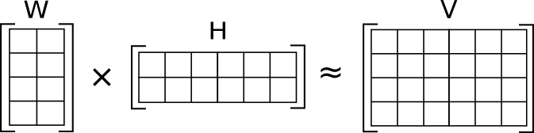
1. Feature engineer
1. Euclidean distance
Compute the pairwise distance of the fiducial point, 3003 features
2. Dimensionality reduction
NMF, reduce to 300 features
The matrix V is represented by the two smaller matrices W and H, which, when multiplied, approximately reconstruct V.
NMF has an inherent clustering property, i.e., it automatically clusters the columns of input data
PCA, 320 principal components explaining 90% of the variance

Slide 4
2. Model Selection
Baseline: GBM without dimensionality reduction
Improved:
Ridge and LASSO regression
Voting classifier of random forest and GBM
SVM model
Neural network
Our Goals:
To improve classification accuracy of different emotions
To reduce model runtime

Slide 5
2.1 Baseline GBM
 | Hyperparameter | Runtime | Accuracy Rate
Binary Classifier | 'learning_rate': 0.01 'max_depth': 5 'max_features': 20 'n_estimators': 50 | 20.0 min | 0.677
Multi-class classifier | 'learning_rate': 0.1 'max_depth’: 5 'max_features’: 80 'n_estimators': 200 | 171 min | 0.369

Slide 6
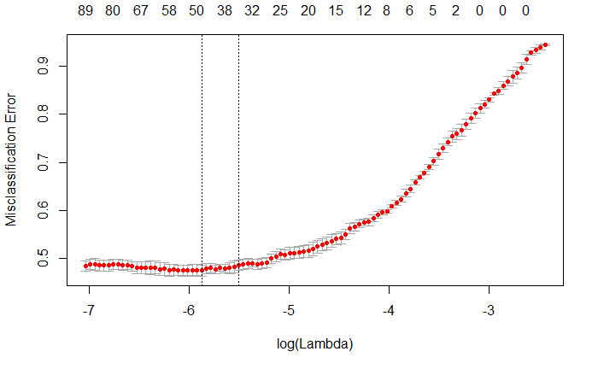


2.2 Neural Network
2.2.1 Ridge and LASSO Regression
Input is feature dataset of Euclidean distances (N = 3003) of fiduciary points.
LASSO (least absolute shrinkage and selection operator) and Ridge Overview:
As LASSO shrinks unimportant coefficients down to 0, offers greater interpretability than Ridge, which keeps all coefficients
Hyperparameter tuning is conducted through 5-fold cross validation iterating through different λ, average classification error across each fold, and at the end of iteration, returning lambda which minimizes error (results of hyperparameter tuning pictured to the right)
Most performant model: LASSO with test-set Accuracy of 53.8%

Slide 7
Binary – multiclass model
Multi-class classifier
Binary classifier
Simple labeled train data
If simple
Input
If compound
Compound labeled train data

Slide 8
2.2.2 SVM
 | Hyperparameter | Runtime | Accuracy Rate
Binary Classifier | 'C': 500, 'kernel': 'linear' | 41.9 s | 0.988
Multi-class: simple | 'C': 500, 'decision_function_shape’:'ovr’, 'kernel': 'rbf' | 16.5s | 0.754
Multi-class: compound | 'C': 50, 'decision_function_shape': 'ovr', 'kernel': 'linear' | 1.4 min | 0.462
Overall: 0.562

Slide 9
2.2.3 Voting Classifier
Random forest 1
Soft voting
 | Accuracy Rate
Multi-class: simple | 0.754
Multi-class: compound | 0.462
Overall: | 0.55
GBM
Class with highest probability
Random Forest 2

Slide 10
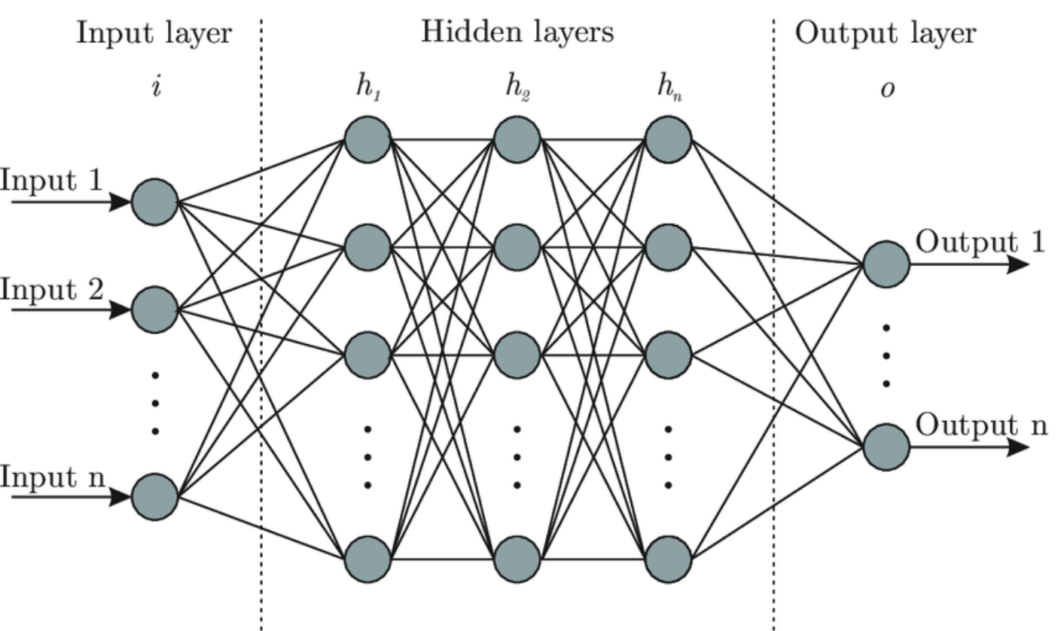
2.2 Neural Network
2.2.4 Neural Net work
Input layer includes preprocessed features from dataset ( ex. Euclidean distance, NMF)
Output layer includes # of classification categories and percentage score of each category based on input data

Slide 11



2.2 Neural Network
2.2.4 Neural Net work
1. Binary Classification Neural Network:
Simple or Compound?
2. Simple Emotion Neural Network:
Output layer: 7 categories
If simple:
Input Layer:
300 Features (same input from the binary NN)
Hidden Layers:
2 network layers (96 Nodes, 64 Nodes) + 2 dropout instances (0.4 and 0.6)
Output Layer:
Simple: 7 Nodes
Compound: 15 Nodes
If compound:
Input Layer:
300 Features {input data is preprocessed via NMF}
Hidden Layers:
2 Layers: 96 Nodes, 64 Nodes (leaky ReLu activation)
+ 2 dropout instances (0.4 and 0.6)
Output Layer:
2 Nodes (softmax activation)
3. Compound Emotion Neural Network:
Output layer: 15 categories

Slide 12
2.2.4 NN Training Process
Split dataset into training set {x} + validation set {y}
Preprocess all Data
Euclidean distance → g();
Feature engineering:
Learn an NMF model from training set {x}; NMF → f()
x' = f(g(x)) ; y’ = f(g(y)) [NOTE: validation set is not used to learn NMF model]
All 3 Neural Networks trained Independently
Binary Classification NN: trained on “simple” and “compound” labels from x’
Simple Classification NN: only trained on 7 categories of “simple” emotions from x’
Compound Classification NN: only trained on 15 categories of “compound emotions from x’
Utilized validation set for parameter tuning + regularization
NOTE: Neural Network Models NEVER trained with the validation dataset
Training Parameters (used by all models)
Optimizer : Adam
Epochs: 100
Batch Size: 128

Slide 13
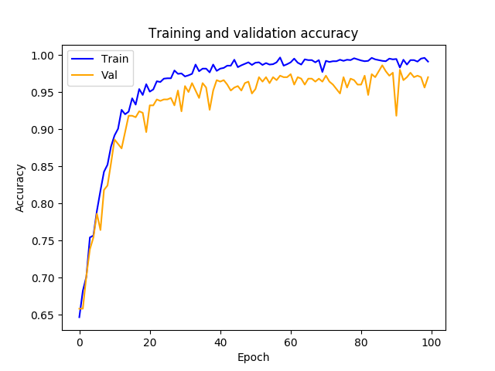
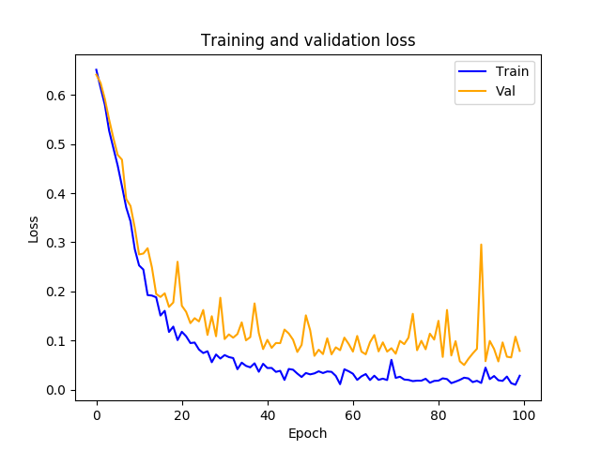
2.2.4 NN Accuracy and Loss

Slide 14
2.2.5 NN Model Summary
 | Hyperparameter | Runtime | Accuracy Rate
Binary Classifier | batch_size = 128, epochs = 100 | 49.0s | 0.96
Multi-class: simple | batch_size = 128, epochs = 100 | 13.6s | 0.85
Multi-class: compound | batch_size = 128, epochs = 100 | 14.62s | 0.62
Overall: 0.682

Slide 15
3. Test result

